Slide 1
Web Development Let’s Break It Down
Scott Beslow
General Assembly - Chicago
January 21, 2016

Slide 2
Scott Beslow
Email: scott.beslow@gmail.com
LinkedIn: linkedin.com/in/scottbeslow
Twitter: @sbeslow
GitHub: sbeslow

Slide 3
Let’s Break It Down
Discuss the tools, concepts, and thought behind web programming
Conceptual
Learn through example
Stop me and ask questions

Slide 4
food inspections

Slide 5
By the end of this class
Have the tools to play with our demo
Seeds for a career change?
Understand your dorky friends and acquaintances

Slide 6
GitHub – Build software together
http://www.github.com
A place to store and share the code
Open-source: Freely available
Graphic interface for git
Track code changes over time and by developer
BitBucket (five free private repos)
Notes:
CREATE AN ACCOUNT HERE

Slide 7
What is Web Programming?
Notes:
How do we interact with the internet?
On what devices – laptops, desktops, tablets, smartphones
What do we do on it?
Let’s pick a website.

Slide 8
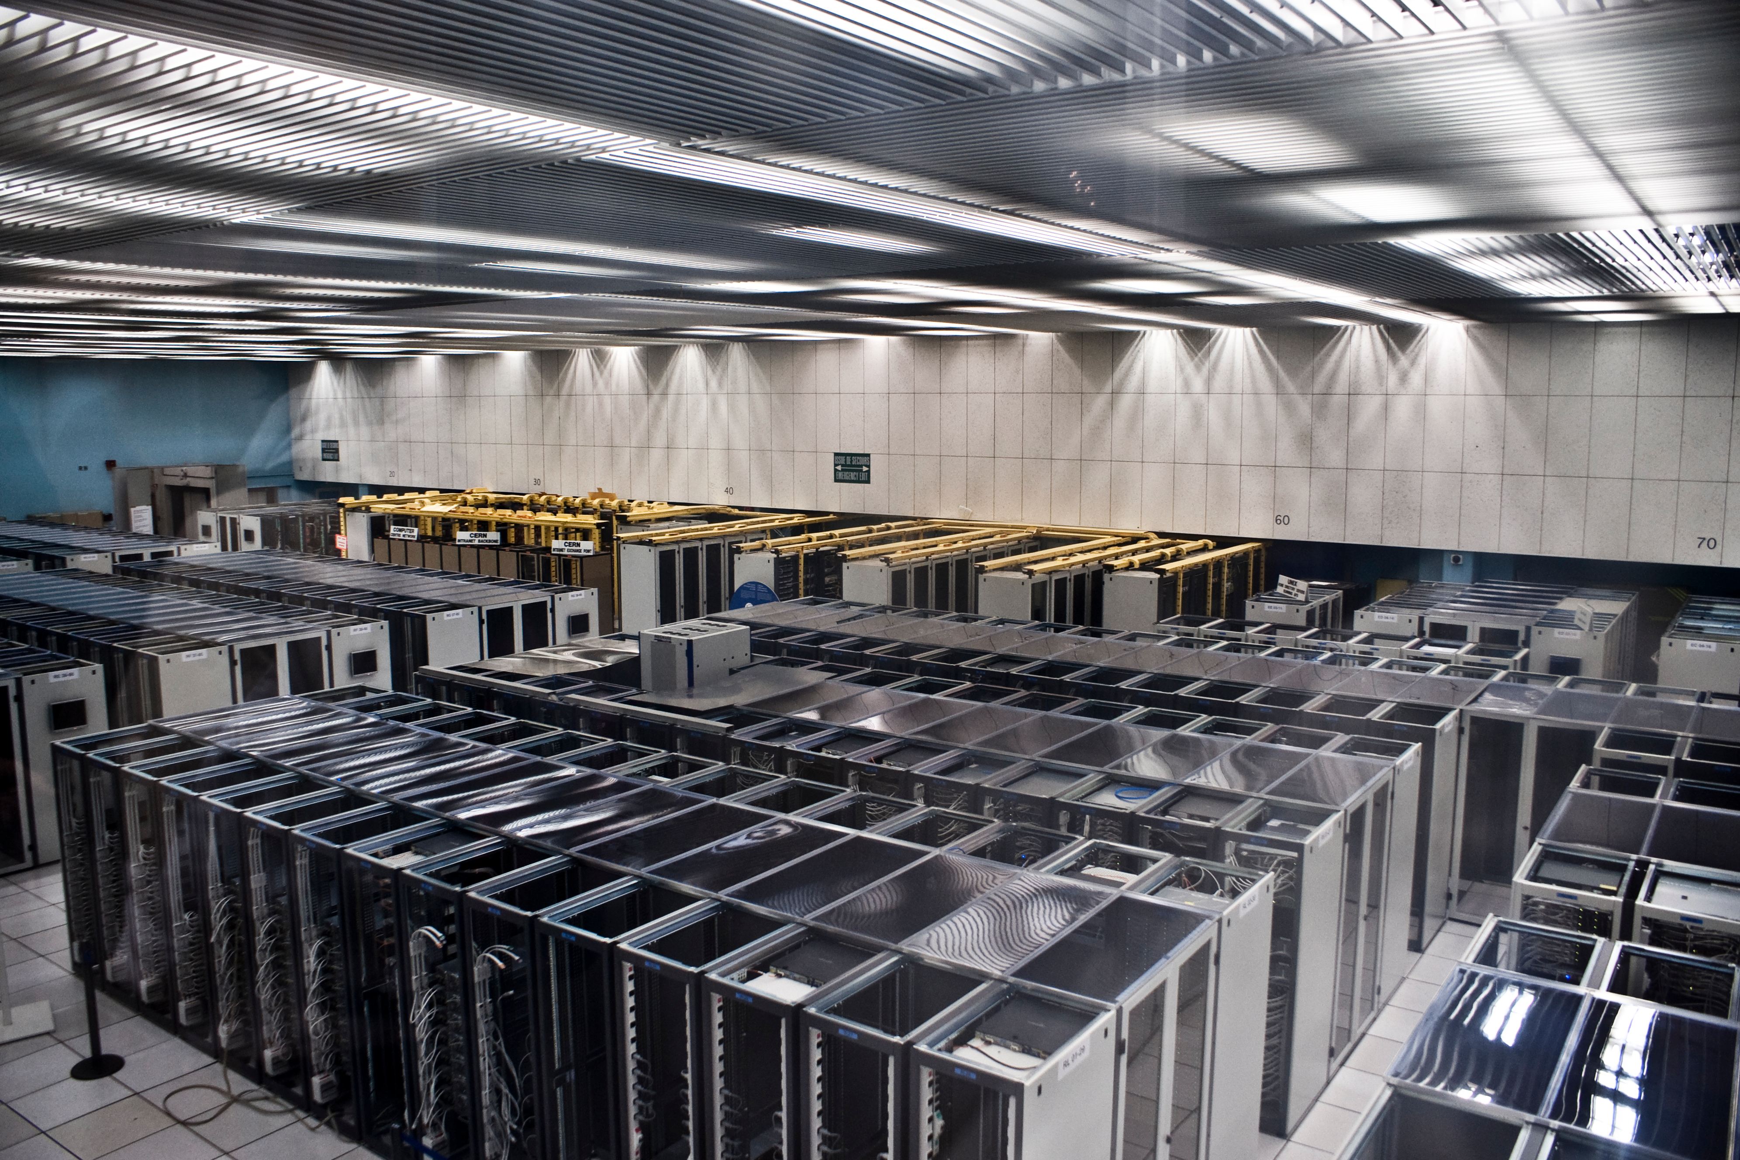

Slide 9
Solving the same problem with many languages
Front End
Back End
HTML
CSS
Javascript
Objective C/Swift (iOS)
Java (Android)
PHP (Wordpress)
Python
Ruby
Java
C#
C++
Javascript
Notes:
Front end – you’ll see that these three languages run in conjunction
Back end – small programs will usually be written in one of these. Big corporations though, have several back end servers running
Is there a best language? Depends on who you ask.

Slide 10
Databases
An organized collection of data
We want to search through large amounts of data (you might even say big data) in a short period of time
How we want to access data determines how we want to store data

Slide 11
Comparing a Few Databases
Relational (MySQL, Postgres)
Flexible, easy, popular, old standard
Think spreadsheets
NoSQL (Mongo)
Unstructured Data
Graph (Neo4j)
Relationships between data
In Memory (Redis)

Slide 12
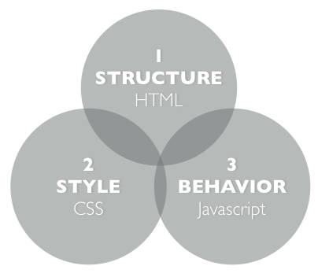

Slide 13
(Twitter) Bootstrap
A framework for developing responsive, mobile first projects on the web
http://www.getbootstrap.com
CP Method (copy-paste)

Slide 14
IDE
An integrated development environment is a program that you write code in (The MS Word of coding).
We’re going to use Brackets.io

Slide 16
Data Retrieval
API – Application Programming Interface
RESTful API – Representational State Transfer
JSON – Javascript Object Notation
AJAX – Asynchronous Javascript and XML
Notes:
Introduce our sample dataset

Slide 17
Pushing to the web
Github hosts web pages for free
http://[username].github.io/[repoName]
git checkout --orphan gh-pages

Slide 18
Next Steps
Look at code, handouts from the repo at https://github.com/sbeslow/
Create a GitHub account
Install git or the GitHub app
https://windows.github.com
https://mac.github.com
Clone the repo on your machine and play around

Slide 19
Potential Projects
Make it look nice
Include search by address
Show a map (HINT: use Javascript library)
Display data from other projects from the Open Data Portal
Or look around for other APIs

Slide 20
where is papacito’s?

Slide 21
Our Design Pattern
Database
Restaurants
Webpage rendering
Code to show webpage on client
Web Server
Sending data through API
Parsing out per restaurant

Slide 22
MVC Framework
Model Database
Food Inspection reports
View Webpage rendering
Code to show webpage on client
HTML, CSS, Javascript
Controller Web Server Controller
Sending data through API
Parsing out per restaurant

Slide 23
Common MVC Frameworks
A single application that covers all three M-V-C components
Spring, Play! Framework (Java)
ASP .NET (C#)
Django (Python)
Ruby On Rails (Ruby)
Nodejs (Javascript)
AngularJS, React (Javascript)

Slide 24
How do I put this onto the internet?
Cloud Service Platforms
Such as Amazon Web Services (AWS), Heroku, Microsoft Azure, Google Cloud Platform

Slide 25
Final Thoughts
Learn by doing
The internet is your friend
Stack Overflow
Work with people
Seek instruction
Multitude of subject areas, pick one

Slide 26
Questions?

